Slide 1

STATS 293 Applied Statistics with R
ANOVA Tables

Slide 2


ANOVA Tables
One-Way ANOVA:
The information below shows the model equation and ANOVA table for a completely randomised balance design one-way ANOVA. Here there are k population groups each with n observations.
Model Equation:
$Y_{i,j} = μ + α_{i} + ε_{i,j} ∀ i=1,…,k j=1,…,n$
$$\sum_{i=1}^{k}{α_{i}}=0$$
where
$ε_{i,j} \sim N(0,\text{σ}\text{2})$
and we have the constraint
ANOVA Table:
Source of Variation | df | SS | Mean Square | F-Statistic
Total | N-1 = kn-1 | TSS
Treatment | k-1 | SST | MST = SST / (k-1) | MST / MSE
Residual | k (n-1) | SSE | MSE = SSE / [ k (n-1) ]
2

Slide 3

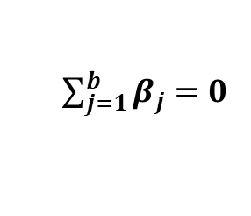
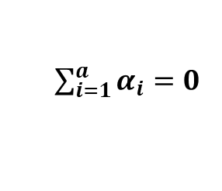
ANOVA Tables
Randomized Block Design (Fixed Effects Model):
The information below shows the model equation and ANOVA table for a balanced randomised block design fixed effects model with a factor levels, b blocking levels and n replicates.
Model Equation:
$$Y_{ijk} = μ + α_{i} + β_{j} + ε_{ijk} ∀ i=1,…,a j=1,…,b k=1,…, n$$
where
$ε_{ijk} \sim N(0,\text{σ}\text{2})$
and we have the constraints
$\sum_{i=1}^{a}{α_{i}=0}$
$\sum_{j=1}^{b}{β_{j}=0}$
ANOVA Table:
Source of Variation | df | SS | Mean Square | F-Statistic
Total | N-1 | TSS
Treatment | a-1 | SST | MST = SST / (a-1) | MST / MSE
Blocks | b-1 | SSB | MSB = SSB / (b-1) | MSB / MSE
Residual | N-a-b+1 | SSE | MSE = SSE / (N-a-b+1)
3

Slide 4

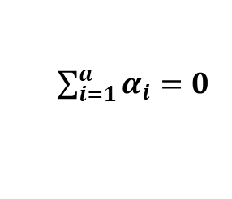
ANOVA Tables
Randomized Block Design (Mixed Effects Model):
The information below shows the model equation and ANOVA table for a balanced randomised block design mixed effects model with a factor levels, b blocking levels and n replicates.
Model Equation:
$$Y_{ijk} = μ + α_{i} + B_{j} + ε_{ijk} ∀ i=1,…,a j=1,…,b k=1,…, n$$
where
$ε_{ijk} \sim N(0,\text{σ}\text{2})$
and
$B_{j} \sim N( 0, σ_{B}^{2} )$
and we have the constraints
$\sum_{i=1}^{a}{α_{i}=0}$
ANOVA Table:
Source of Variation | df | SS | Mean Square | F-Statistic
Total | N-1 | TSS
Treatment | a-1 | SST | MST = SST / (a-1) | MST / MSE
Blocks | b-1 | SSB | MSB = SSB / (b-1) | MSB / MSE
Residual | N-a-b+1 | SSE | MSE = SSE / (N-a-b+1)
4

Slide 5
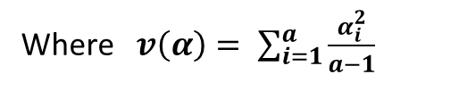

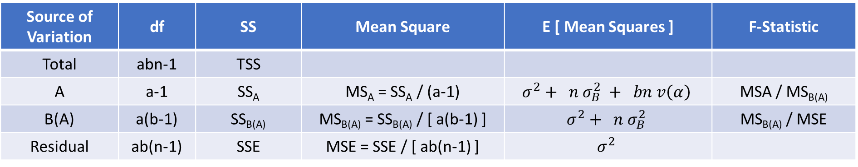
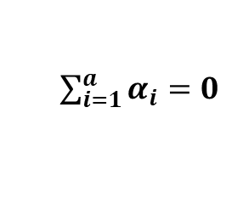

ANOVA Tables
Two-Stage Nested Design with Mixed Effects:
The information below shows the model equation and ANOVA table for a mixed effects, balanced 2-stage nested design. Here Factor A has a levels, Factor B has b levels (nested inside Factor A) and there are n replicates.
Model Equation:
$Y_{ijk} = μ + α_{i} + B_{j(i)} + ε_{k(ij)}$ $∀ i=1,…,a j=1,…,b k=1, …, n$
where
$ε_{k(ij)} \sim N(0,\text{σ}\text{2})$
and
$B_{j(i)} \sim N( 0, σ_{B}^{2} )$
and we have the constraints
$\sum_{i=1}^{a}{α_{i}=0}$
ANOVA Table:
Source of Variation | df | SS | Mean Square | E [ Mean Squares ] | F-Statistic
Total | abn-1 | TSS
A | a-1 | SS_{A} | MS_{A} = SS_{A} / (a-1) | $$σ^{2}+ n σ_{B}^{2} + bn v\left(α\right)$$ | MSA / MS_{B(A)}
B(A) | a(b-1) | SS_{B(A)} | MS_{B(A)} = SS_{B(A)} / [ a(b-1) ] | $$σ^{2}+ n σ_{B}^{2}$$ | MS_{B(A)} / MSE
Residual | ab(n-1) | SSE | MSE = SSE / [ ab(n-1) ] | $$σ^{2}$$
Where $v\left(α\right)= \sum_{i=1}^{a}{\frac{α_{i}^{2}}{a−1}}$
5

Slide 6
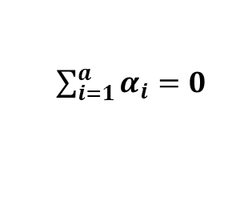


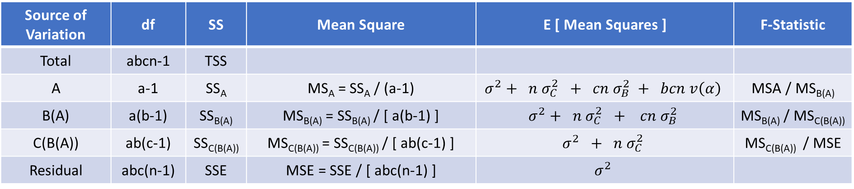


ANOVA Tables
Three-Stage Nested Design with Mixed Effects:
The information below shows the model equation and ANOVA table for a mixed effects, balanced 3-stage nested design. Here Factor A has a levels, Factor B has b levels (nested inside Factor A), Factor C has c levels (nested inside Factor B) and there are n replicates.
Model Equation:
$$Y_{ijkm} = μ + α_{i} + B_{j(i)} + C_{k(ij)} + ε_{m(ijk)} ∀ i=1,…,a j=1,…,b k=1, …, c m=1,…,n$$
where
$ε_{m(ijk)} \sim N(0,\text{σ}\text{2})$
$B_{j(i)} \sim N( 0, σ_{B}^{2} )$
and
$$C_{k(ij)} \sim N\left(0, σ_{C}^{2}\right)$$
and we have the constraint
$\sum_{i=1}^{a}{α_{i}=0}$
ANOVA Table:
Source of Variation | df | SS | Mean Square | E [ Mean Squares ] | F-Statistic
Total | abcn-1 | TSS
A | a-1 | SS_{A} | MS_{A} = SS_{A} / (a-1) | $$σ^{2}+ n σ_{C}^{2} + cn σ_{B}^{2} + bcn v\left(α\right)$$ | MSA / MS_{B(A)}
B(A) | a(b-1) | SS_{B(A)} | MS_{B(A)} = SS_{B(A)} / [ a(b-1) ] | $$σ^{2}+ n σ_{C}^{2} + cn σ_{B}^{2}$$ | MS_{B(A)} / MS_{C(B(A))}
C(B(A)) | ab(c-1) | SS_{C(B(A))} | MS_{C(B(A))} = SS_{C(B(A))} / [ ab(c-1) ] | $$σ^{2} + n σ_{C}^{2}$$ | MS_{C(B(A))} / MSE
Residual | abc(n-1) | SSE | MSE = SSE / [ abc(n-1) ] | $$σ^{2}$$
6
Where $v\left(α\right)= \sum_{i=1}^{a}{\frac{α_{i}^{2}}{a−1}}$

